Slide 1

Business Analytics
Senior Management Program
Soumyakanti Chakraborty

Slide 2
Module Objectives
What is it that data scientists do?
What does data science involve?
How does data science help businesses?
Notes:
2

Slide 3
Agenda
Machine Learning Algorithms
What is Data Science?
Practical Examples

Slide 4
Tool
Knime (www.knime.com)
Drag and Drop
Completely GUI based
Notes:
4

Slide 5
Data Science - Process
1. Question
2. Data
2. Data
3. Exploratory Data Analysis
3. Exploratory Data Analysis
4. Formal Modelling
4. Formal Modelling
5. Interpretation
6. Communication
7. Result

Slide 6
“Machine Learning: Field of study that gives computers the ability to learn without being explicitly programmed.”
Machine Learning
Traditional Programming
Data
Computer
Output
Rules
Machine Learning
Data
Computer
Rules
Output

Slide 7
Categories of Machine Learning
Supervised Learning Unsupervised Learning
Model trained on historical data. Resulting model can be used to make predictions on new data.
Algorithm finds trends and patterns in data, without prior training on historical data.
Use Case: Predicting a value based on patterns discovered in previous data.
Use Case: Describing your data based on statistical analysis.

Slide 8
Machine Learning Algorithms - Examples
Supervised Learning Unsupervised Learning
Clustering
Classification
Logistic Regression
K-Means

Slide 9
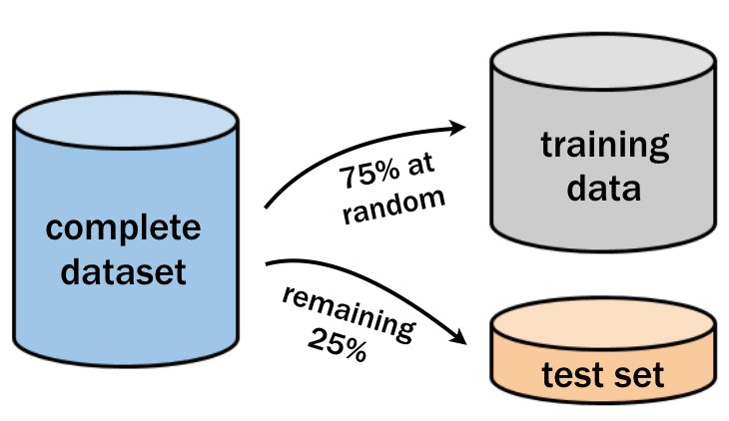
Machine Learning – Data Preparation

Slide 10
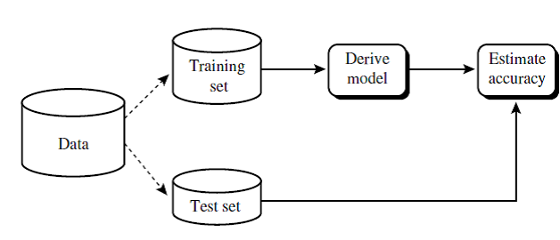
Machine Learning – Data Preparation

Slide 11
Machine Learning – Key Takeaways
The two main types of Machine Learning are Supervised and Unsupervised Learning
Training and Test data preparation is an important step in the process
Machine Learning Algorithms are merely tools. Good results come from understanding how they work and tuning them correctly.

Slide 12
Machine Learning – Algorithms
Association Rule Mining – Market Basket Analysis
Clustering
Logistic Regression

Slide 13
Association Rule Mining (Market Basket Analysis)

Slide 14
ID | Apples | Bread | Cheese | Dates | Eggs | Fish | Grapes | Honey | Ice-Cream
1 | 1 | 1 |  | 1 |  |  | 1 | 1
2 |  |  | 1 | 1 | 1
3 |  | 1 | 1 |  |  | 1
4 |  | 1 |  |  |  | 1 |  |  | 1
5 |  |  |  |  | 1 |  | 1
6 |  |  |  |  |  | 1 |  |  | 1
7 | 1 |  |  | 1 |  |  |  | 1
8 |  |  |  |  |  | 1 |  |  | 1
9 |  |  | 1 |  | 1
10 |  | 1 |  |  |  |  | 1
11 |  |  |  |  | 1 |  | 1
12 | 1
13 |  |  | 1 |  |  | 1
14 |  |  | 1 |  |  | 1
15 |  |  |  |  |  |  |  | 1 | 1
16 |  |  |  | 1
17 | 1 |  |  |  |  | 1
18 | 1 | 1 | 1 | 1 |  |  |  | 1
19 | 1 | 1 |  | 1 |  |  | 1 | 1
20 |  |  |  |  | 1
Notes:
Example Market Basket – only 20 transactions from a fictitious supermarket which sells only 9 items. Imagine the size of the data for a supermarket with 10 big stores across the length and breadth of a metro city selling, may be, thousands of items.

Slide 15
Support
Support – Given an itemset L, the support of L is the percentage of transactions that contain L.
What is the support of {eggs}?
25%
What is the support of {apples, bread}
15%
What is the support of {eggs, grapes}
10%
Notes:
15

Slide 16
Discovering Rules
Rule – If a basket contains X, it is likely to contain Y.
X – apples, Y – bread. So, the rule that is being mentioned is that if a customer buys apples he is likely to buy bread.
The rule is depicted as {apples} → {bread}
X could be {apples, bread}, Y – {dates}. Therefore, the rule is, if a customer buys apples and breads he is likely to buy dates.
It is depicted as {apples, bread} → {dates}

Slide 17
Measures of Rules - Confidence
Confidence of a rule {X} → {Y}
When the if part is true, how often is the then part true?
Confidence (X → Y) = Support ({X ^ Y})/Support({X})
Consider the rule {Bread, Eggs} → {Milk}
Support of {Bread ^ Eggs ^ Milk} – 0.2
Support of {Bread ^ Eggs} – 0.2
Confidence of the rule {Bread, Eggs} → {Milk}?
1

Slide 18
Measures of Rules - Lift
Lift of a rule {X} → {Y}
Really related or coincidental?
Lift (X → Y) = Support ({X ^ Y})/Support({X}) * Support({Y})
10000 transactions from an electronics store
Transactions which has video games – 7500
Transactions which has computer games – 6000
Transactions which has both computer games and video games – 4000
Rule – {Computer games} → {Video games}
Confidence ?
Lift?
Confidence = 4000/10000/6000/10000 = 0.67
Lift = 4000/10000/((6000/10000) * (7500/10000)) = 0.89

Slide 19
Measures of Rules - Lift
1000 transactions
{Milk, Eggs} – 300
{Milk} – 500
{Eggs} – 400
Lift of the rule {Milk} → {Eggs}?
1.5

Slide 20
Cluster Analysis

Slide 21





Slide 23




Slide 25
K-Means
If you want to see K clusters, then run K-means.
It works by generating K points, each point is the centre (or centroid) of one cluster. As the algorithm iterates, the points adjust their positions until they stabilise.
Very simple, fairly fast, very common; a few drawbacks.

Slide 26
K-Means

Slide 27
K-Means
Notes:
Here is the data; we choose k = 2 and run 2-means

Slide 28
K-Means
Notes:
We choose two cluster centres -- randomly

Slide 29
K-Means
Notes:
Step 1: decide which cluster each point is in – the one whose centre is closest

Slide 30
K-Means
Notes:
Step 2: We now have two clusters – recompute the centre of each cluster

Slide 31
K-Means
Notes:
These are the new centres

Slide 32
K-Means
Notes:
Step 1: decide which cluster each point is in – the one whose centre is closest

Slide 33
K-Means
Notes:
This one has to be reassigned:

Slide 34
K-Means
Notes:
Step 2: We now have two new clusters – recompute the centre of each cluster

Slide 35
K-Means
Notes:
Centres now slightly moved

Slide 36
K-Means
Notes:
Step 1: decide which cluster each point is in – the one whose centre is closest

Slide 37
K-Means
Notes:
In this case, nothing gets reassigned to a new cluster – so the algorithm is finished

Slide 38
Regression
Linear Regression
Simple Linear Regression
Multiple Linear Regression

Slide 39

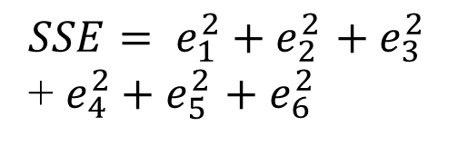
Simple Linear Regression
y
e₆
e₅
e₂
e₄
y_{a}
e₁
e₃
y_{p}
x₁
x

Slide 40
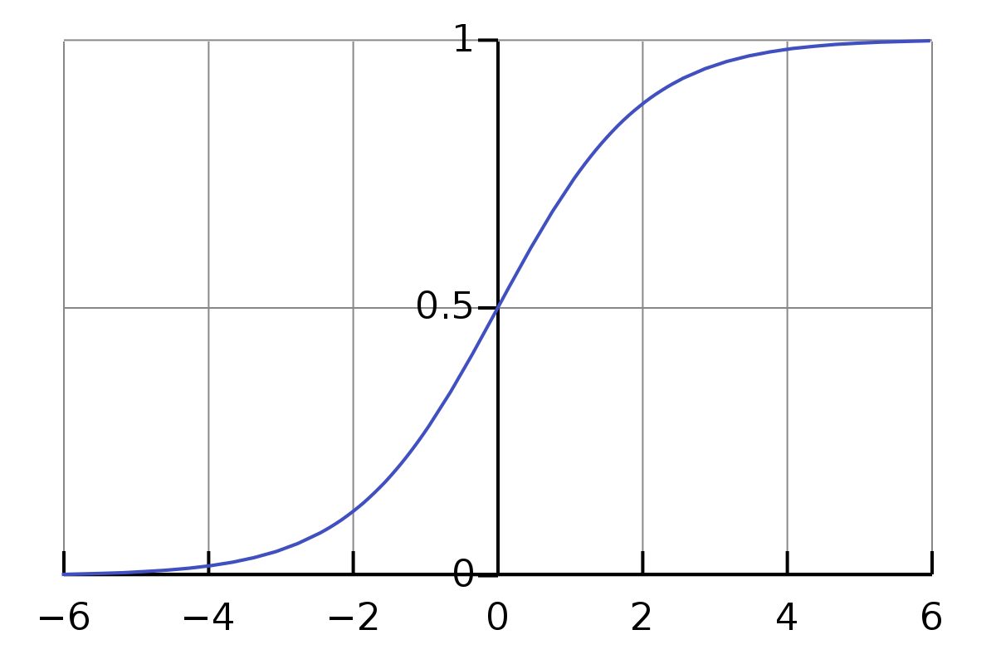
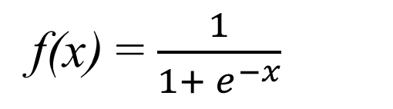
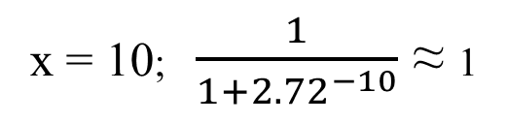
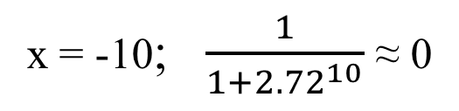
Logistic Function

Slide 41
Classification – Evaluating the Algo

Slide 42
The Four Values
True Positive: Model predicts Positive and it is True
True Negative: Model predicts Negative and it is True
False Positive: Model predicts Positive and it is False (Type I Error)
False Negative: Model predicts Negative and it is False (Type II Error)

Slide 43
Confusion Matrix
 |  | Actual Values
 |  | Positive | Negative
Predicted Values | Positive | True Positive (TP) | False Positive (FP)
 | Negative | False Negative (FN) | True Negative (TN)

